Slide 1

CS401 Modern Programming Practices (MPP) Dr. Shafqat Ali Shad
MAHARISHI UNIVERSITY of MANAGEMENT
Engaging the Managing Intelligence of Nature
Computer Science Department

Slide 2
© 2015 Maharishi University of Management, Fairfield, Iowa
All rights reserved. No part of this slide presentation may be reproduced or utilized in any form or by any means, electronic or mechanical, including photocopying or recording, or by any information storage and retrieval system, without permission in writing from Maharishi University of Management.

Slide 3
Lecture 10:Best Programming Practices with Java 8 Living Life in Accord with Natural Law

Slide 4
Wholeness Statement
Best practices in the world of OO programming are a way of ensuring quality in code. Code that adheres to best practices tends to be easier to understand, easier to maintain, more capable of adapting in the face of changing requirements and new feature requests, and more reusable for other projects. This simple theme is reflected in individual life. There are laws governing life, both physical laws and laws pertaining to all kinds of relationships and interactions. When life flows in accordance with the laws of nature, life is supported for success and fulfillment. When awareness becomes established at its deepest level, actions and behavior springing from this profound quality of awareness spontaneously are in accord with the laws of nature.

Slide 5
Overview
Unit-testing Stream Pipelines
Introduction to Annotations
Using Java 8’s try-with-resources
Handling Exceptions Arising in Stream Pipelines
Concurrent Processing and Parallel Streams

Slide 6
How to Unit Test Stream Pipelines?
The Problem. Stream pipelines, with lambdas mixed in, form a single unit; it is not obvious how to effectively unit test the pieces of the pipeline.
Two Guidelines:
If the pipeline is simple enough, we can name it as an expression and unit test it directly.
If the pipeline is more complex, pieces of pipeline can be called from support methods, and the support methods can be unit-tested.

Slide 7
Unit-Testing Stream Pipelines: Simple Expressions
Example: Perform a unit test on the following pipeline:
Function<List<String>, List<String>> allToUpperCase =
words -> words.stream()
.map(word -> word.toUpperCase())
.collect(Collectors.toList());
Can do ordinary unit testing of allToUpperCase.
@Test
public void multipleWordsToUppercase() {
List<String> input = Arrays.asList("a", "b", "hello");
List<String> result = Testing.allToUpperCase.apply(input);
assertEquals(Arrays.asList("A", "B", "HELLO"), result);
}

Slide 8
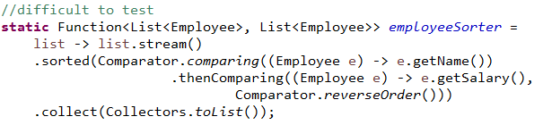
Unit-Testing Stream Pipelines: ComplexExpressions
Example: Sorts Employees first by name (ascending), then by salary in descending order
The key point to test is whether any two Employees are being compared in the correct way.
This can be done by replacing the lambda expression that defines the Comparator with a method reference, together with an auxiliary method that can be placed in a companion class LibraryCompanion.
Demo: lesson10.lecture.libcompanion

Slide 9
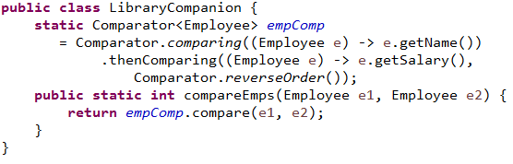
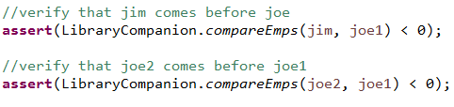
//auxiliary method, used in method reference, in the class LibraryCompanion
Strategy: Refactor the pipeline using auxiliary methods that can be tested separately.
static Function<List<Employee>, List<Employee>> employeeSorter =
list -> list.stream()
.sorted(LibraryCompanion::compareEmps)
.collect(Collectors.toList());
Now the key element of the original lambda can be tested directly:

Slide 10
Unit-Testing Stream Pipelines: ComplexExpressions
The example suggests a best practice for unit testing when lambdas are involved:
Replace a lambda that needs to be tested with a method reference plus an auxiliary method
Then you can test the auxiliary method

Slide 11
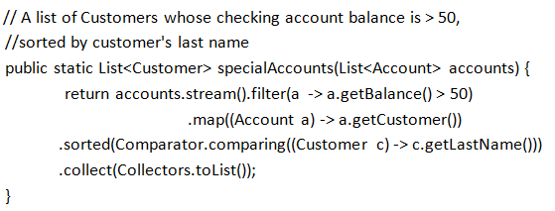
Exercise 10.1
You are developing unit tests and need to decide how to test the lambda expression shown below. Should you treat it as a simple expression or a complex expression? Create a unit test to test it. All necessary files are in package lesson10.exercise_1 in the InClassExercises project. Use the class TestLambda for your test.

Slide 12
Overview
Unit-testing Stream Pipelines
Introduction to Annotations
Using Java 8’s try-with-resources
Handling Exceptions Arising in Stream Pipelines
Concurrent Processing and Parallel Streams

Slide 13
What Are Annotations?
We have seen them in various contexts already:
@Test - JUnit 4
@Override – to indicate that a method is being overridden
@FunctionalInterface – to indicate that an interface is functional and may be used with lambdas
@Deprecated – to discourage use of a method or class
@SuppressWarnings – to hide warning messages of various kinds
Javadoc annotations:
@author
@since
@version

Slide 14
What Are Annotations? (cont.)
Annotations are tags that are inserted into source code so that some tool can process them. The tools can operate on the source level, or they can process class files into which the compiler has placed annotations.
To benefit from annotations that you create, you need to select a processing tool. You need to use annotations that your processing tool understands, then apply the processing tool to your code.
- JUnit processes its @Test annotation - Java compiler processes the others shown
Annotations can be applied to a class, a method, a variable – in fact, anywhere qualifiers like public and static may be used

Slide 15
What Are Annotations? (cont.)
Annotations may have zero or more elements. Here is an example of a user-defined annotation that has two elements, assignedTo and severity.
@BugReport(assignedTo="Harry", severity=10) [This annotation could be applied at the class level. Like any user-defined annotation, it would require an external tool to process it.]
When an annotation has just one element and its name is “value”, the following more compact form can be used:
@SuppressWarnings("unchecked")
[same as @SuppressWarnings(value = "unchecked")]
If the annotations have the same type, then this is called a repeating annotation:
@Author(name = "Jane Doe")
@Author(name = "John Smith")
class MyClass { ... }
Repeating annotations are supported as of the Java SE 8 release

Slide 16
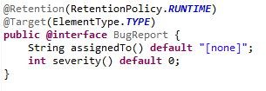
What Are Annotations? (cont.)
User-defined annotations. The @interface keyword is the way the Java compiler knows you are creating an annotation; such “classes” extend the Annotation interface. See the demo lesson10.lecture.annotation
Note: the code shows how the elements "assigned to" and "severity" are defined.

Slide 17
Annotation Reference
@Retention @Retention annotation specifies how the marked annotation is stored:
RetentionPolicy.SOURCE – The marked annotation is retained only in the source level and is ignored by the compiler.
RetentionPolicy.CLASS – The marked annotation is retained by the compiler at compile time, but is ignored by the Java Virtual Machine (JVM).
RetentionPolicy.RUNTIME – The marked annotation is retained by the JVM so it can be used by the runtime environment.
@Target @Target annotation marks another annotation to restrict what kind of Java elements the annotation can be applied to. A target annotation specifies one of the following element types as its value:
ElementType.ANNOTATION_TYPE can be applied to an annotation type.
ElementType.CONSTRUCTOR can be applied to a constructor.
ElementType.FIELD can be applied to a field or property.
ElementType.LOCAL_VARIABLE can be applied to a local variable.
ElementType.METHOD can be applied to a method-level annotation.
ElementType.PACKAGE can be applied to a package declaration.
ElementType.PARAMETER can be applied to the parameters of a method.
ElementType.TYPE can be applied to any element of a class.

Slide 18
Exercise 10.2
Work with the Buganizer code shown in class (available in package lesson10.exercise_2 in InClassExercises). A class StillMoreBadCode has been added. Add to this class annotation values for the elements "assigned to" and "severity". Then integrate this new class into the AnnotationInfo class and run it. Info about StillMoreBadCode should be included in the output report.

Slide 19
Overview
Unit-testing Stream Pipelines
Introduction to Annotations
Using Java 8’s try-with-resources
Handling Exceptions Arising in Stream Pipelines
Concurrent Processing and Parallel Streams

Slide 20
Handling Exceptions with Try-with-Resources
You Wish to Use Resources Carefully. When your application uses external resources, like files or a database connection, it is important to close the connections after your application has finished using them. Typically, using these connections involves checked exceptions; but whether or not an exception is thrown, your application must disconnect from the resource, or there can be a memory leak, causing memory to fill up.
Do clean-up in a finally block. The usual way to clean up resources is in a finally block, which will execute whether or not an exception is thrown.
Complication. But, what if closing a resource is also capable of throwing a checked exception? How should this be handled?
Demo: lesson10.lecture.trickycatch1

Slide 21
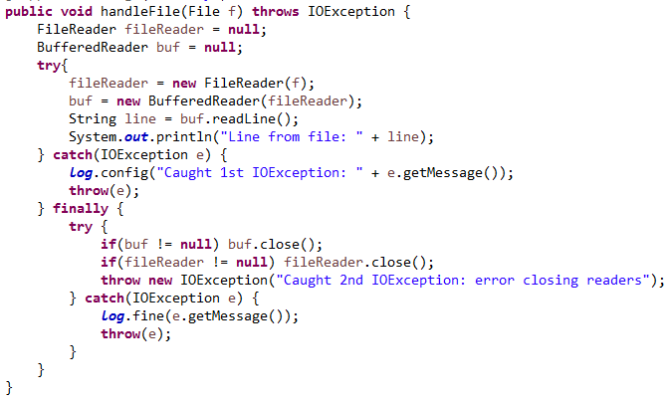
The Closing Resources Problem
Example: Consider this code (lesson10.lecture.trickycatch1):

Slide 22
The Closing Resources Problem (continued)
Some Problems with the Code.
First problem. It's messy and it's easy to implement it incorrectly.
More serious problem. Consider this scenario:
After BufferedReader object is created, a call to readLine causes an IOException to be thrown.
In the finally clause, an attempt is made to close the BufferedReader, but the close() operation also throws an IOException.
Only one exception can be thrown, and the way Java does it is to throw the close operation exception (the one that we don't care about).
In the demo code, the message displayed will be “Caught 2nd IOException: error closing reader.” The IOException indicating a failure to execute readLine() is lost.
.
Demo: lesson10.lecture.trickycatch1.MyClass2

Slide 23
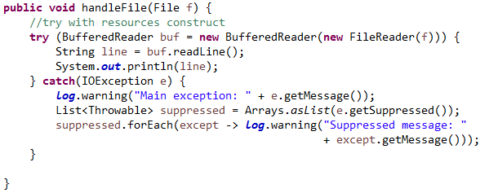
The Try-with-Resources Solution
Here is the Java 8 alternative to the previously displayed code:
Demo: lesson10.lecture.trickycatch4_trywithres.MyClass

Slide 24
The try-with-resources Solution (cont.)
Notes
The resources named in the "try" clause – in this case, a BufferedReader – will be closed at the completion of the try block.
If an exception is thrown during execution of try and an error occurs in closing these resources, the close exceptions will automatically be appended to the main exception as suppressed exceptions.
If no main exception occurs, but a close exception occurs, the close exception is thrown in the usual way.
It is now possible to read the suppressed exceptions using the getSuppressed() method, which returns a list of Throwables. These can be read and handled if desired, but the main exception is the one that is thrown and caught.

Slide 25
Exercise 10.3
Use the try-with-resources construct to rewrite the class OldFileIO, which reads a file word_test.txt using pre-Java 8 approach. The necessary files are in the InClassExercises project, in the lesson10.exercise_3 package. Do the following:
Include a catch clause to catch the primary IOException if there is one.
In your catch clause, loop through and print any suppressed exceptions that may be thrown (as in the slides)
Notice how the file word_test.txt is accessed in OldFileIO (see FILE_LOCATION constant). Should this be improved? How?

Slide 26
More About Resources
A resource is an object that must be closed after the program is finished with it. The try-with-resources statement ensures that each resource is closed at the end of the statement.
Another example of a resource that can be managed with try-with-resources is the Connection object, invoked in interacting with a database, using JDBC. Handling exceptions and closing the connection in the right way and in the right sequence has tended to be error-prone. Using try-with-resources, it is straightforward to write code in the correct way.
See Demo lesson10.lecture.jdbc.read_trywithres. To run the code, you need to set up JavaDB. To do this, see setup/setting-up-javadb

Slide 27
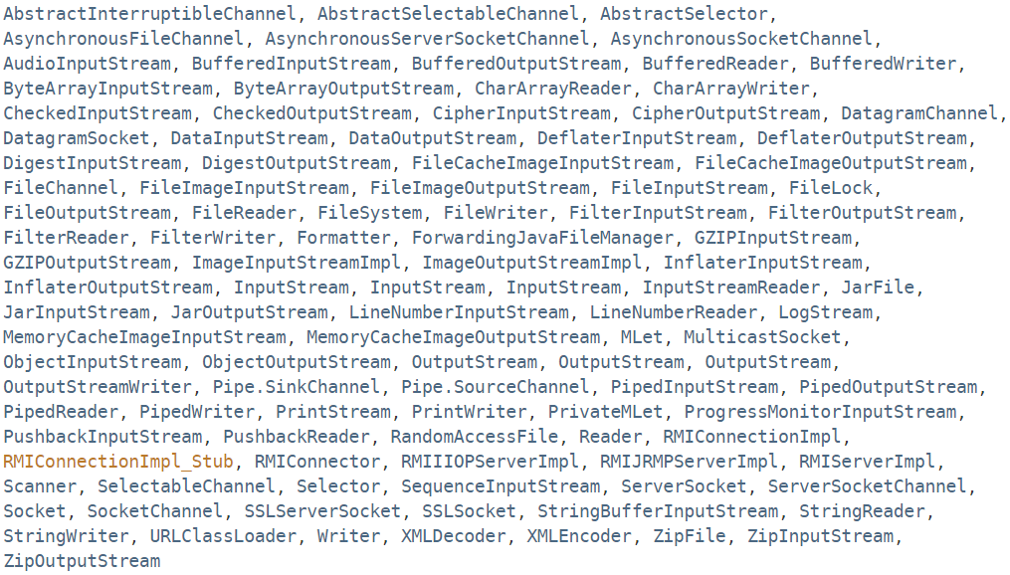
Resources in Java 8 Which Can Be Used with try-with-resources
Any object that implements java.lang.AutoCloseable, which includes all objects that implement java.io.Closeable, can be used as a resource. The classes in Java 8 that implement AutoCloseable are listed here:

Slide 28
Main Point 1
Java's new try-with-resources construct handles the complex logic behind exception-handling when the process requires that a resource be "closed" after its use. Earlier versions of Java required developers to handle this situation with an error-prone imperative programming style; Java's new approach is declarative: The developer just tells the runtime which resources will be used and the runtime takes care of the close operations, including exception-handling. This effortless approach to handling code has a parallel in the domain of human life: When individual awareness is sufficiently attuned to this deeper levels of consciousness, very little effort is required to achieve significant success.

Slide 29
Overview
Unit-testing Stream Pipelines
Introduction to Annotations
Using Java 8’s try-with-resources
Handling Exceptions Arising in Stream Pipelines
Concurrent Processing and Parallel Streams

Slide 30
Handling Exceptions Arising in Stream Pipelines
Ordinary functional expressions, composed in a pipeline, may throw exceptions, but very often exception-handling can be done in the usual way. See demo code in lesson10.lecture.exceptions.
However, stream operations, like map and filter, that require a functional interface whose unique method does not have a throws clause (like Function and Predicate), make exception-handling more difficult. See demo code to see issues and best possible solutions. lesson10.lecture.exceptions2
The best one can do in these situations is to convert checked exceptions to RuntimeExceptions. The code can be made more readable and compact if the try/catch clause that is needed can be tucked away in an auxiliary method. Examples are provided in lesson10.lecture.exceptions3, lesson10.lecture.exceptions.connectold, and lesson10.lecture.exceptions.connectnew

Slide 31
Overview
Unit-testing Stream Pipelines
Introduction to Annotations
Using Java 8’s try-with-resources
Handling Exceptions Arising in Stream Pipelines
Concurrent Processing and Parallel Streams

Slide 32
Concurrent Processing and Parallel Streams - Overview
Introduction to threads
Working with threads: the Runnable interface
Thread safety and the synchronized keyword
Java 8 convenience class for invoking threads: the Executor class
When should you use parallel streams?

Slide 33
Introduction to Threads
A process in Java is an instance of a Java program that is being executed. It contains the program code and its current activity. A process has a self-contained execution environment. A process generally has a complete, private set of basic run-time resources; in particular, each process has its own memory space.
A thread is a component of a process. Multiple threads can exist within the same process, executing concurrently (one starting before others finish) and sharing memory (and other resources), while different processes do not share these resources. In particular, the threads of a process share the values of its variables at any given moment.
Every process has at least one thread, the main thread (the main method of a Java program starts up the main thread.) Other threads may be created from the main thread.

Slide 34
Introduction to Threads (cont.)
Multiple threads are typically invoked to perform multiple tasks simultaneously, or to simulate simultaneous execution of multiple tasks. In a multiprocessor environment, different threads can access different processors; in a single processor environment, multiple threads can appear to work simultaneously by virtue of time-slicing – the operating system allots portions of time to competing threads.
Examples of how multiple threads are used:
One thread keeps a UI active while another thread performs a computation or accesses a database
Divide up a long computation into pieces and let each thread compute values for one piece, then combine the results (computing in parallel)
Web servers typically handle client requests on separate threads; in this way, many clients can be served “simultaneously.”

Slide 35
Creating Threads in Java
Code that you wish to run in a new thread is contained in the run() method of a class that implements the Runnable interface.
interface Runnable { void run() ; } class MyRunnable implements Runnable {
public void run() {
System.out.println("Running a thread!");
}
}

Slide 36
Creating Threads in Java (cont.)
The thread is then spawned when an instance of your class is used as an argument to the Thread constructor, and the start() method is called on the Thread instance.
The following code creates a thread and starts it:
MyRunnable myRunnable = new MyRunnable();
Thread t = new Thread(myRunnable);
t.start();

Slide 37
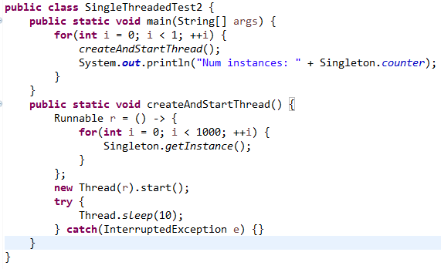
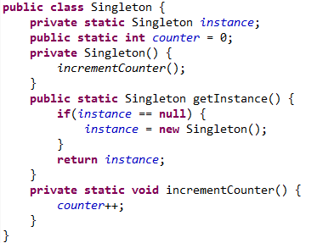
Testing Singleton Using a Single Thread
As expected, only 1 instance is ever created.
Note: We have put each thread to sleep for 10 milliseconds before allowing the next one to start. If we do not do this, then the first 1 or 2 calls of createAndStart will record 0 instances. This is because the change made by each thread may not be visible to the main thread immediately (this is most likely because processor memory is much faster than the RAM where the counter data is stored).

Slide 38
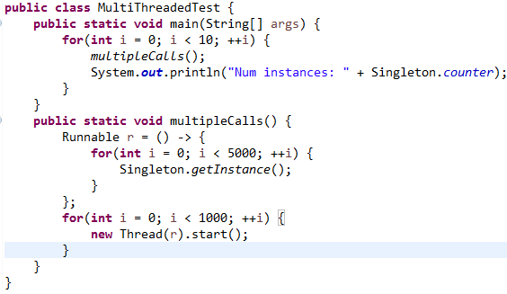
Testing Singleton Using Multiple Threads
The test shows that competing threads are creating multiple instances of the Singleton class. The test “instance == null” is being interrupted so that it appears to be true to more than one thread, and so the constructor is called multiple times.

Slide 39
Race Conditions and Thread Safety
When two or more threads have access to the same object and each modifies the state of the object, this situation is called a race condition, which arises when threads interfere with each other (the sequence of steps being executed by one thread is interrupted by another thread).
Code is said to be thread-safe if it is guaranteed to be free of race conditions when accessed by multiple threads simultaneously.
We can say therefore that this Singleton implementation is not thread-safe.

Slide 40
Forcing Serialized Access with synchronized
We can force threads to access the getInstance method of Singleton one at a time (this is called serialized access) by labeling getInstance with the keyword synchronized.
When a method is synchronized, in order for a thread to execute the method, it must acquire the lock for the instance of the object that the method is running on. Each object has an instrinsic lock, and a thread gains access to this lock when it calls the method, as long as no other thread has the lock. Once a thread executes the synchronzied method, the lock becomes available again and the next eligible thread (determined by the OS using thread priorities and other factors) then acquires the lock.

Slide 41
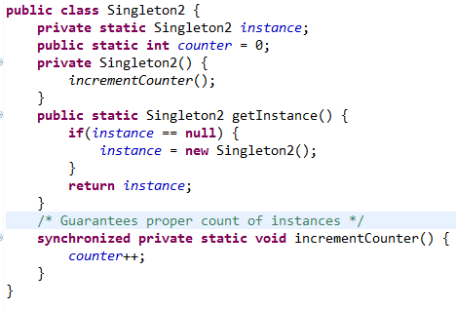
Forcing Serialized Access with synchronized (cont.)
Note: This use of the word “serialized” has nothing to do with the Serializable interface that we examined earlier in the course
Note: We have seen that competing threads could corrupt the “== null” test. However, competing threads could also corrupt the counter since the increment operation counter++ is not atomic (it is in fact the assignment counter = counter + 1). Therefore, to be sure that the MultiThreadedTest is really producing multiple instances of Singleton, we must make the incrementCounter method synchronized, as in the code below. Running this test, and witnessing multiple calls to the Singleton constructor once again convinces us that multiple instances are being created.

Slide 42
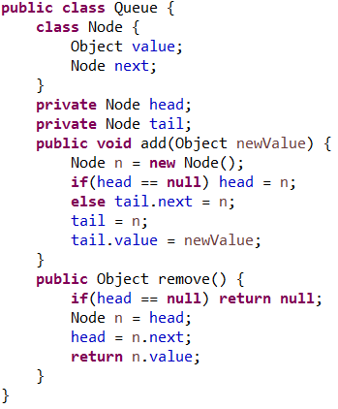
Exercise 10.4
The code to the right is an implementation of the Queue data type. Are its operations threadsafe? If not, think of a test you could do, involving multiple threads, that would prove that it is not. (You do not need to write any code, but you will in the lab, so you will be able to use the ideas you come up with now.)

Slide 43
Exercise 10.4 Solution
Multi-threaded access of Queue can lead to any of the following inconsistent states:
Can force the queue to have fewer than the net number of adds
Can for the queue to have more than the net number of adds
Can for the remove operation to generate a NullPointerException by trying to access a next node from a node that is already null.
See the document Lesson 10 - Vulnerabilities in the Queue Implementation

Slide 44
Main Point 2
Code that will perform flawlessly in a single-threaded environment may bring disastrous consequences in a multi-threaded environment if shared data is not managed properly.
In life, a similar situation exists because the particulars of life are always changing. In any domain of life – work, family, health, society – a situation that appears favorable today may become unfavorable tomorrow. How does one prepare for change that cannot be predicted? The only way is to be established in a part of oneself that does not change, no matter how the world changes. That part is first experienced as simple silence in the practice of TM. In time, with regular practice, it becomes firmly established.

Slide 45
Starting and Managing Threads with Executor
When many threads need to be managed, starting threads in the way shown above is not optimal. To create and manage threads properly, Java has an Executor class.
Two examples of specialized Executor classes:
Executors.newCachedThreadPool() - optimized for creation of threads for performing many small tasks or for tasks which involve long wait periods.
Executors.newFixedThreadPool(numThreads) – for computationally intensive tasks

Slide 46
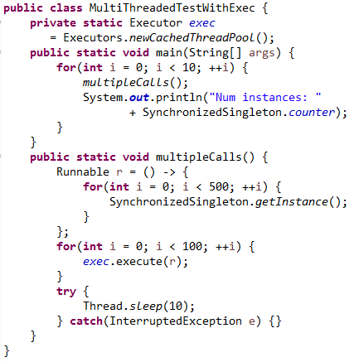
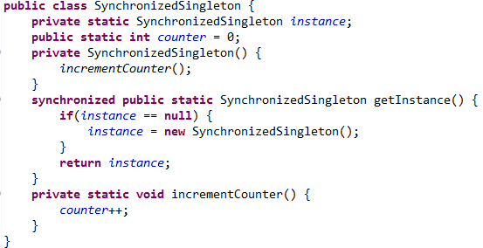
Starting and Managing Threads with Executor (cont.)
We modify our earlier code to make use of this the Executor class. We synchronize the getInstance method in SynchronizedSingleton.
Note: You may notice that the program waits a bit after the last printout. It terminates when the pooled threads have been idle for a while; after some time, the executor terminates them.

Slide 47
Guidelines for Using Parallel Streams
When you create a parallel stream from a Collection class in order to process elements in parallel, Java handles this request by partitioning the collection and processing each piece with a separate thread. Not every Stream operation, nor every underlying collection type, works well with parallel processing. We give general guidelines for choosing between sequential and parallel streams.

Slide 48
Guidelines for Using Parallel Streams (cont.)
Some Guidelines
Don’t use parallel streams if the number of elements is small – the improved performance (if any) will not in this case outweigh the overhead cost of working with parallel streams.
Operations that depend on the order of elements in the underlying collection should not be done in parallel. Example: findFirst, limit.
If the terminal operation of the stream is expensive (example: collect(Collectors.joining)), you must remember that it will be executed repeatedly in a parallel computation – this could be a good reason to avoid parallel streams in this case.
Translation between primitives and their object wrappers becomes very expensive when done in parallel. If you are working with primitives, use the primitive streams, like IntStream and DoubleStream.
Certain data structures can be divided up more efficiently than others – ArrayList, HashSet and TreeSet can be partitioned efficiently, but LinkedLists cannot. (In a LinkedList, how can a section of the list be extracted and processed separately?)
Until you develop a degree of expertise in working with parallel computations, it is a good idea to benchmark the performance of a pipeline executed in parallel and compare with the performance of the sequential version.

Slide 49
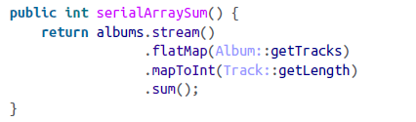
Sample Benchmarks for Sequential vs Parallel Processing
Warburton, Java 8 Lambdas (p. 84) gives an example of a benchmark test that makes a convincing case for choosing parallel processing over sequential processing for a particular task.
Sequential Version of Code
//counts the total number of //tracks on all albums

Slide 50
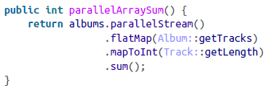
Sample Benchmarks for Sequential vs Parallel Processing (cont.)
Parallel Version of Code
Warburton reports that, when running on a quad core Windows machine, when the number of albums was just 10, the sequential version was 8x faster; when number of albums was 100, the two versions were equally fast; when the number of albums was 10,000, the parallel version was 2.5x faster.

Slide 51
Connecting the Parts of Knowledge With the Wholeness of Knowledge Annotations
Executing a Java program results in algorithmic, predictable, concrete, testable behavior.
Using annotations, it is possible for a Java program to modify itself and interact with itself.
Transcendental Consciousness is the field self-referral pure consciousness. At this level, only one field is present, continuously in the state of knowing itself.
Impulses Within the Transcendental Field. What appears as manifest existence is the result of fundamental impulses of intelligence within the field of pure consciousness. These impulses are ways that pure consciousness acts on itself, interacts with itself.
Wholeness Moving Within Itself. In Unity Consciousness, the diversity of creation is appreciated as the play of fundamental impulses of one’s own nature, one’s own Self.

